Slide 1
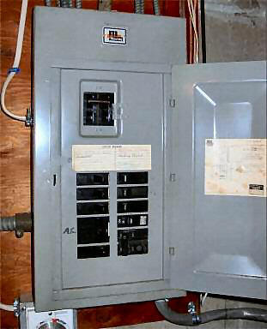
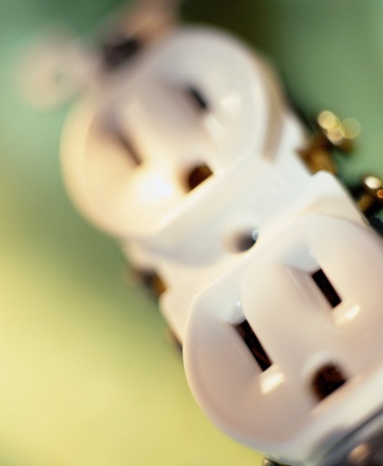
ELECTRICAL SAFETY OSHA 29 CFR 1910 SUBPART S
Bureau of Workers’ Comp
PA Training for Health & Safety (PATHS)

Slide 2
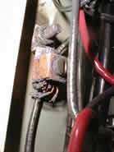
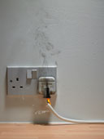
Electrical Injuries
AN AVERAGE OF ONE WORKER IS
ELECTROCUTED ON THE JOB EVERY DAY!
There are four main types of electrical injuries:
Electrocution (death due to electrical shock)
Electrical Shock
Burns
Falls

Slide 3
Electrical Terminology
▪ CURRENT = The movement of electrical charge.
▪ RESISTANCE = Opposition to current flow.
▪ VOLTAGE = A measure of electrical force.
▪ CONDUCTORS = Substances, such as metals, that have little resistance to electricity.
▪ INSULATORS = Substances, such as wood, rubber, glass and bakelite, that have high resistance to electricity.
▪ GROUNDING = A conductive connection to the earth which acts as a protective measure.

Slide 4
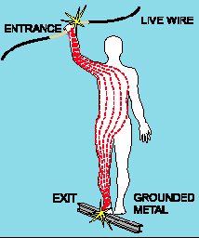
Electrical Shock
Received when current passes through the body.
Severity of the shock depends on:
Path of current through the body
Amount of current flowing through the body
Length of time the body is in the circuit
LOW VOLTAGE DOES NOT MEAN LOW HAZARD!

Slide 5
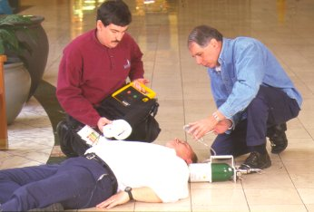
Dangers of
Electrical Shock
Currents greater than 75mA (1/1,000 of an ampere) can cause ventricular fibrillation (rapid, ineffective heartbeat)
Will cause death in a few minutes unless a defibrillator is used.
75mA is not much current –a small power drill uses 30 times as much.

Slide 6
How is an Electrical Shock Received?
When two wires have different potential voltages, current will flow if they are connected.
In most household wiring the black wires are at 110 volts relative to ground.
The white wires are at zero volts because they are connected to ground.
Contact with an energized (live) black wire while touching the white grounded wire = ELECTRICAL SHOCK!

Slide 7
How is a an Electrical Shock Received? (cont.)
Contact with an energized wire/any energized electrical component + any grounded object = SHOCK!
You can even receive an electrical shock when you are not in contact with a ground.
CONTACT BOTH WIRES OF A 240 VOLT CABLE =
SHOCK, POSSIBLE ELECTROCUTION!

Slide 8
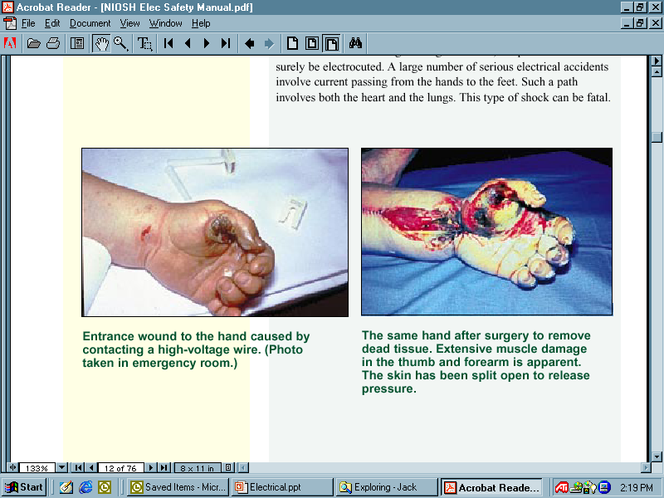
Electrical Burns
Are the most common shock-related nonfatal injury
Occur when you touch electrical wiring or equipment that is improperly used or maintained
Typically occurs on the hands
Very serious injury that needs immediate attention

Slide 9
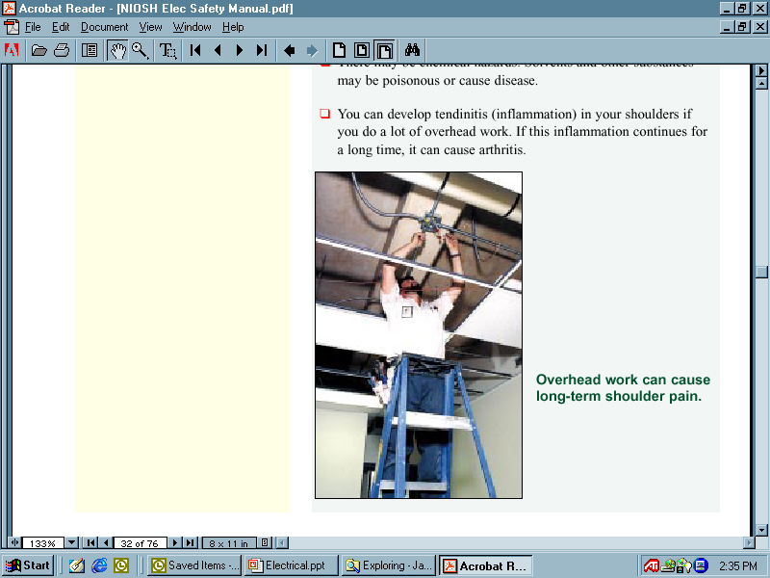
Falls
Electrical shock can also cause indirect or secondary injuries.
Employees working in an elevated location who experience a shock can fall, resulting in serious injury or even death.

Slide 10
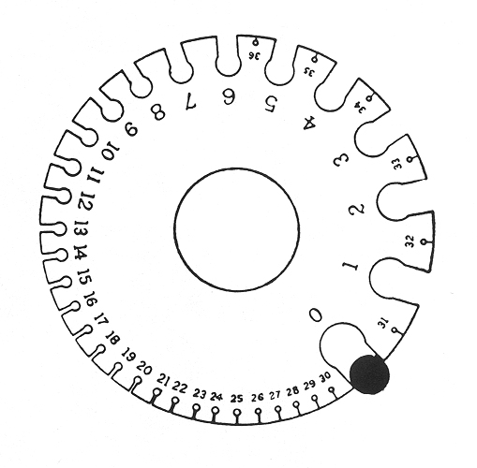
Inadequate Wiring Hazards
A hazard exists when a conductor is too small to safely carry the current. Example: Using a portable tool with an extension cord that has a wire
too small for the tool.
Tool draws more current than cord can handle = overheating, possible fire without tripping the circuit breaker
Circuit breaker could be the right size for the circuit but not for the smaller wire extension cord
Wire Gauge
Wire gauge measures wires ranging in size from number 36 to 0 American wire gauge (AWG)
WIRE

Slide 11
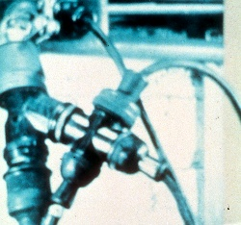
Hazards of Overloading
Too many devices plugged into circuit = wires heat to very high temperature = possible fire
Wire insulation melts = arcing may occur = fire in area where overload exists (even inside a wall)

Slide 12
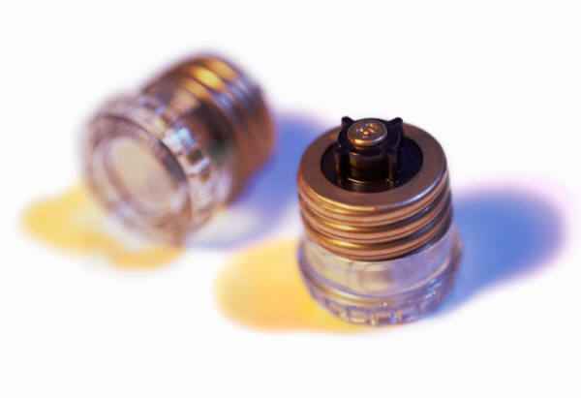
Electrical Protective
Devices
Shut off electricity flow in the event of an overload or ground-fault in the circuit.
Include fuses, circuit breakers and ground-fault circuit interrupters, or CGCI.
Fuses and circuit breakers are “over current” devices (too much current = fuses melt and circuit breakers “trip” open).

Slide 13
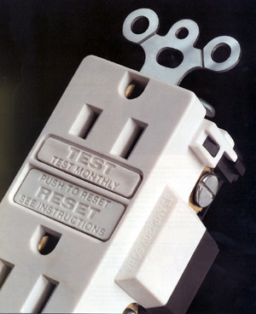
Ground Fault Circuit Interrupter
Protects you from dangerous electrical shock.
Detects a difference in current between the black and white circuit wires (could happen when electrical equipment is not working properly causing a current “leakage” known as ground fault).
Ground fault detected = GFCI can shut off electricity flow in as little as 1/40 of a second protecting you from a dangerous shock.

Slide 14
Grounding Hazards
Some of the most frequently violated OSHA standards.
Metal parts of an electrical wiring system that we touch should be at 0 volts relative to ground (switch plates, ceiling light fixtures, conduit, etc.).
Housings of motors, appliances or tools that are plugged in to improperly grounded circuits may become energized.
If you come into contact with an improperly grounded electrical device YOU WILL GET SHOCKED!

Slide 15
Some Examples of OSHA Electrical Requirements
GROUNDING PATH
The path to ground from circuits, equipment and enclosures must be permanent and continuous.
The violation shown here is an extension cord with the third/grounding prong missing.

Slide 16
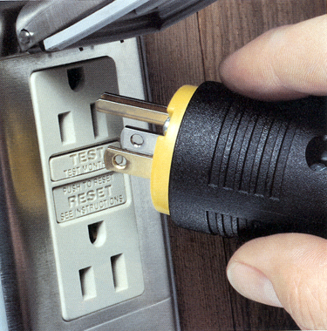
Examples of OSHA Requirements
HAND-HELD ELECTRICAL TOOLS:
Hand-held electrical tools pose a potential danger because they make continuous good contact with the hand.
To protect you from shock, burns and electrocution, tools must:
Have a 3-wire cord with ground and be plugged into a grounded receptacle
Be double insulated
Be powered by a low-voltage isolation transformer

Slide 17
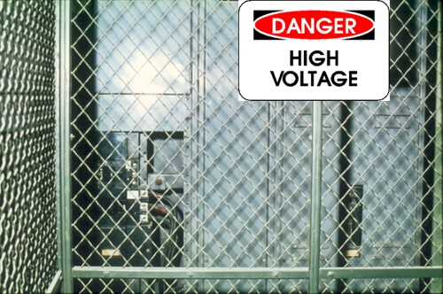
Guarding Live Parts
Must guard “live” parts of electric equipment operating at > 50 volts against accidental contact by:
Approved cabinets/enclosures
Location or permanent partitions (thereby only accessible to qualified persons)
Elevation of 8 feet or more above the floor or working surface
Mark entrances to guarded locations with conspicuous warning signs

Slide 18
Guarding Live Parts
Where electrical equipment is in locations that it can suffer physical damage it must be guarded.
The violation shown here is physical damage to conduit.

Slide 19
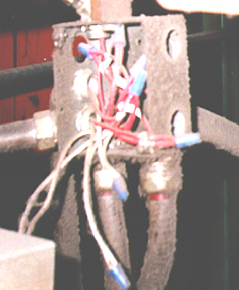
Cabinets, Boxes, Fittings
Junction boxes, pull boxes and fittings must have approved covers.
Unused openings in cabinets, boxes and fittings must be closed (no missing “knockouts”).
Photo shows violations of these two requirements.

Slide 20
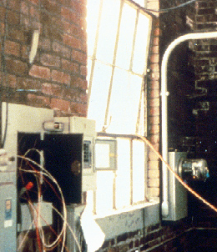
Use of Flexible Cords
Are more vulnerable than fixed wiring.
Should not be used if recognized wiring methods can be used instead.
Flexible cords can be damaged by:
Aging
Door or window edges
Staples or fastenings
Abrasion from adjacent materials
Activities in the area
Improper use of flexible cords can cause shocks, burns or fire.

Slide 21
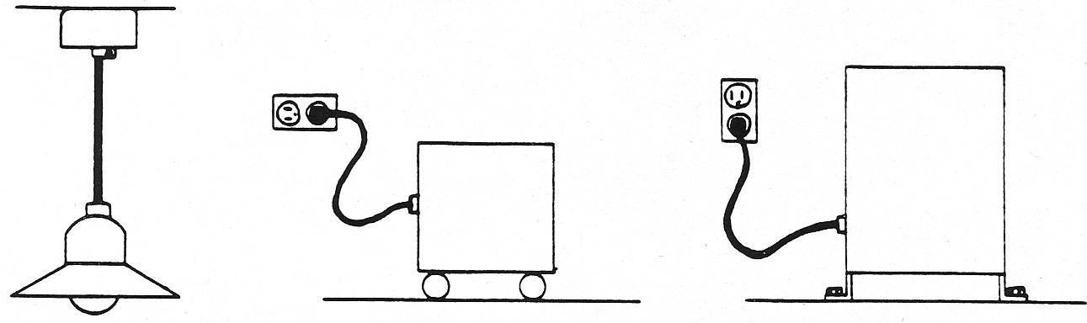
Examples – Permissible Uses of Flexible Cords
Pendant or Fixture Portable lamps, Stationary equipment
Wiring tools or appliances to facilitate interchange

Slide 22
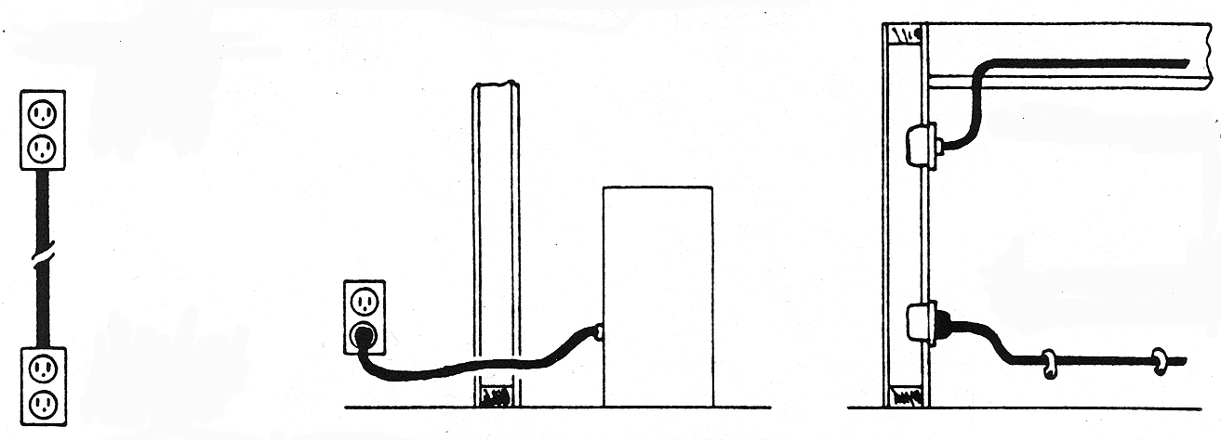
Examples – Prohibited Uses of Flexible Cords
Substitute for Run through walls, ceilings Concealed behind
fixed wiring floors, doors, or windows or attached to
building surfaces

Slide 23
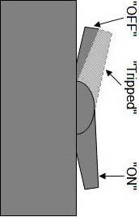
Electrical Hazards –
Clues
Tripped circuit breakers or blown fuses
Warm tools, wires, cords, connections or junction boxes
GFCI that shuts off a circuit
Worn or frayed insulation around wire or connection

Slide 24
Training
Train employees working with electrical equipment in safe working practices including:
De-energizing electrical equipment before inspecting or making repairs
Using electric tools in good repair
Using good judgment when working near energized lines
Using appropriate protective equipment, or PPE

Slide 25
Summary
Hazards
Inadequate wiring
- Exposed electrical parts
- Wires with bad insulation
- Ungrounded electrical tools/systems
- Overloaded circuits
- Damaged power tools/equipment
Overhead power lines
All hazards are made worse in wet conditions!

Slide 26
Summary
Protective Measures
▪ Proper grounding
▪ Using GFCIs
▪ Using fuses and circuit breakers
▪ Proper use of flexible cords
▪ Training

Slide 27

Conclusion
The bottom line with electricity:
RESPECT
COMMON SENSE
SAFETY

Slide 28

Questions

